Slide 1



PARULINSTITUTEOF ENGINEERING &TECHNOLOGY
FACULTY OF ENGINEERING & TECHNOLOGY
PARULUNIVERSITY
Subject: Artificial Intelligence
Unit 2 : Search techniques:
ASHWANI CHAUDHARY
Computer Science & Engineering

Slide 2


UNIT-2
Search Techniques

Slide 3


Unit 2
Generate-And-Test, Hill Climbing, Best-First Search, Problem Reduction, Constraint Satisfaction, Means-Ends Analysis. Heuristic search, Hill Climbing, Best first search, mean and end analysis, Constraint Satisfaction, A* and AO* Algorithm, Knowledge Representation: Basic concepts, Knowledge representation Paradigms, Propositional Logic, Inference Rules in Propositional Logic, Knowledge representation using Predicate logic, Predicate Calculus, Predicate and arguments, ISA hierarchy, Frame notation, Resolution, Natural Deduction

Slide 4

Generate and Test Search
is a heuristic search technique based on Depth First Search with Backtracking which guarantees to find a solution
Algorithm
Generate a possible solution.
Test to see if this is a actual solution by comparing the chosen point or the endpoint
If a solution is found, quit. Otherwise go to Step 1

Slide 5
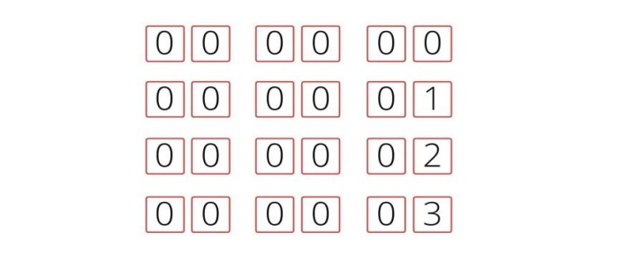
Properties of Good Generators:
Complete: they should generate all the possible solutions
Non Redundant: Good Generators should not yield a duplicate solution
Informed: Good Generators have the knowledge about the search space
In this case, one way to find the required pin is to generate all the solutions in a brute force manner for example,
The total number of solutions in this case is (100)³ which is approximately 1M.
Now consider using heuristic function where we have domain knowledge that every number is a prime number between 0-99 then the possible number of solutions are (25)³ which is approximately 15,000.

Slide 6
Hill Climbing
A hill-climbing algorithm is a local search algorithm that moves continuously upward (increasing) until the best solution is attained.
Generate and Test variant: Hill Climbing is the variant of Generate and Test method. The Generate and Test method produce feedback which helps to decide which direction to move in the search space.
Greedy approach: Hill-climbing algorithm search moves in the direction which optimizes the cost.
No backtracking: It does not backtrack the search space, as it does not remember the previous states.

Slide 7
Algorithm(Hill Climbing)
1. Examine the current state, If Current State = Goal State, Return success and exit
Else if New state is better than current state then Goto New state
return to step 1
Exit

Slide 8
Different regions in the state space landscape:
Local Maximum: Local maximum is a state which is better than its neighbor states, but there is also another state which is higher than it.
Global Maximum: Global maximum is the best possible state of state space landscape. It has the highest value of objective function.
Current state: It is a state in a landscape diagram where an agent is currently present.
Flat local maximum: It is a flat space in the landscape where all the neighbor states of current states have the same value.
Shoulder: It is a plateau region which has an uphill edge.

Slide 9
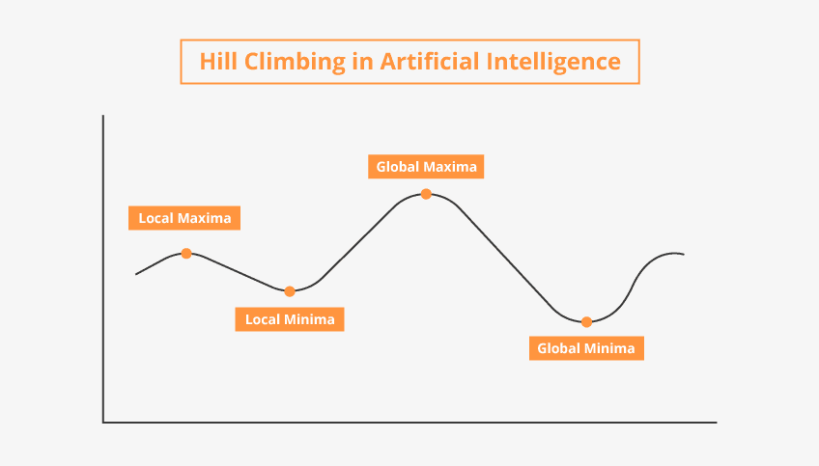

Slide 10
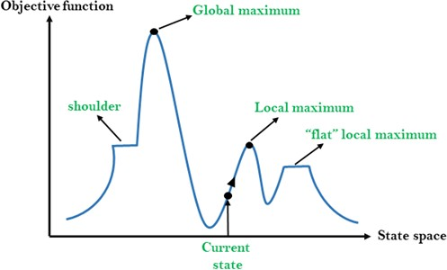

Slide 11
Advantage of Hill Climbing algorithm:
simple and intuitive algorithm that is easy to understand and implement.
efficient in finding local optima good choice for problems where a good solution is needed quickly.
The algorithm can be easily modified and extended

Slide 12
Disadvantages of Hill Climbing algorithm
It can get stuck in local maxima, and may never find the global maxima of the problem.
a poor initial solution may result in a poor final solution.
does not explore the search space very thoroughly
It may be less effective than other optimization algorithms, such as genetic algorithms or simulated annealing, for certain types of problems.

Slide 13
Best-First Search
Informed Search Algorithms
Heuristics function(used in Informed Search, and it finds the most promising path)
Greedy Search(always selects the path which appears best at that moment)

Slide 14
Best first search algorithm:
Step 1: Place the starting node into the OPEN list.
Step 2: If the OPEN list is empty, Stop and return failure.
Step 3: Remove the node n, from the OPEN list which has the lowest value of h(n), and places it in the CLOSED list.
Step 4: Expand the node n, and generate the successors of node n.
Step 5: Check each successor of node n, and find whether any node is a goal node or not. If any successor node is goal node, then return success and terminate the search, else proceed to Step 6.
Step 6: For each successor node, algorithm checks for evaluation function f(n), and then check if the node has been in either OPEN or CLOSED list. If the node has not been in both list, then add it to the OPEN list.
Step 7: Return to Step 2.

Slide 15
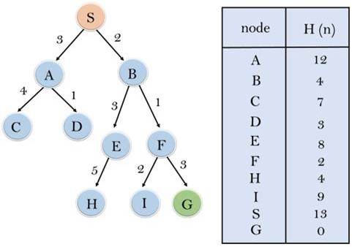
Eg:

Slide 16
Advantages:
Best first search can switch between BFS and DFS by gaining the advantages of both the algorithms.
This algorithm is more efficient than BFS and DFS algorithms.
Disadvantages:
It can behave as an unguided depth-first search in the worst case scenario.
It can get stuck in a loop as DFS.
This algorithm is not optimal.
Time Complexity: The worst case time complexity of Greedy best first search is O(b^{m}).
Space Complexity: The worst case space complexity of Greedy best first search is O(b^{m}).
Where b is the number of legal moves at each point and m is the maximum depth of the tree.

Slide 17
Problem Reduction
divide and conquer strategy
decomposing it into smaller sub-problems
sub-solutions can then be recombined to get a solution as a whole
is called Problem Reduction.
method generates arcs: AND arc(connected) and OR arc

Slide 18
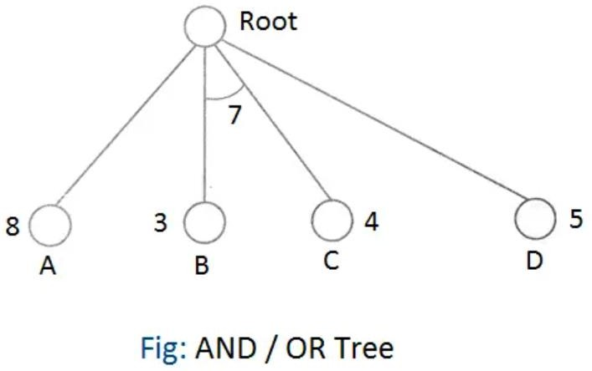
AND Arc eg: Charging a phone
Phone & charger & power supply
OR arc eg: Unlocking a phone
Face or Pin or fingerprint

Slide 19
Constraint Satisfaction
constraint satisfaction means solving a problem under certain constraints or rules.
problem is solved when its values satisfy certain constraints or rules of the problem
Constraint satisfaction depends on three components, namely:
X: It is a set of variables.
D: It is a set of domains where the variables reside. There is a specific domain for each variable.
C: It is a set of constraints which are followed by the set of variables.

Slide 20
The constraint value consists of a pair of {scope, rel}. The scope is a tuple of variables which participate in the constraint and rel is a relation which includes a list of values which the variables can take to satisfy the constraints of the problem.
C1=((v1,v2) (v1<>v2))
Constraint1 =scope=V1 &V2 where V1<>V2

Slide 21
Means-Ends Analysis Algorithm
We have studied the strategies which can reason either in forward or backward
but a mixture of the two directions is used to solve complex problems
It limits the search
Works
1.First, evaluate the difference between Initial State and final State. 2.Select the various operators which can be applied for each difference. 3.Apply the operator at each difference, which reduces the difference
between the current state and goal state.

Slide 22
Algorithm for Means-Ends Analysis:
Step 1: Compare CURRENT to GOAL, if there are no differences between both then return Success and Exit.
Step 2: Else, select the most significant difference and reduce it by doing the following steps until the success or failure occurs.
Select a new operator O which is applicable for the current difference, and if there is no such operator, then signal failure.
Attempt to apply operator O to CURRENT. Make a description of two states.
O-Start, a state in which O?s preconditions are satisfied.
O-Result, the state that would result if O were applied In O-start.
If
(First-Part <------ MEA (CURRENT, O-START)
And
(LAST-Part <----- MEA (O-Result, GOAL), are successful, then signal Success and return the result of combining FIRST-PART, O, and LAST-PART.

Slide 23
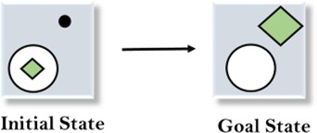
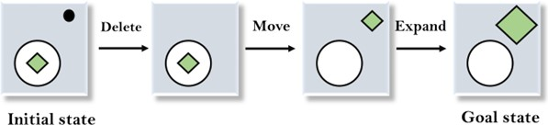
Example of Mean-Ends Analysis:

Slide 24
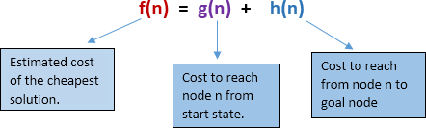
A* Algorithm
A* search is the most commonly known form of best-first search.
used to find the shortest path between two nodes in a graph
Fitness Function(F Score) = Actual Cost + Estimated Cost
It is widely used in various applications, including robotics, video games, and route planning systems.
The cost function combines the actual cost of reaching a node from the start node (known as the "g-score") and an estimated cost of reaching the goal node from the current node

Slide 25
Algorithm of A* search:
Step1: Place the starting node in the OPEN list.
Step 2: Check if the OPEN list is empty or not, if the list is empty then return failure and
stops.
Step 3: Select the node from the OPEN list which has the smallest value of evaluation function (g+h), if node n is goal node then return success and stop, otherwise
Step 4: Expand node n and generate all of its successors, and put n into the closed list. For each successor n', check whether n' is already in the OPEN or CLOSED list, if not then compute evaluation function for n' and place into Open list.
Step 5: Else if node n' is already in OPEN and CLOSED, then it should be attached to the
back pointer which reflects the lowest g(n') value.
Step 6: Return to Step 2.

Slide 26
Advantages of A*
Optimality: A* guarantees finding the shortest path between a given start and goal node, provided that certain conditions are met
Efficiency: A* is typically more efficient than brute-force search algorithms like breadth-first search or depth-first search, especially in large graphs.
Flexibility: A* can be applied to a wide range of problems, including pathfinding in grids, maps, or networks
Speed: A* is often faster than other uninformed search algorithms because it intelligently prioritizes the exploration of nodes.

Slide 27
Disadvantages of A*
Heuristic Accuracy: The performance of A* heavily relies on the accuracy of the heuristic function used
Memory Requirements: A* needs to keep track of the nodes in the open and closed sets during the search process.
Computational Complexity: Although A* is generally efficient, its worst- case time complexity is exponential. In graphs with many possible paths or when using a poor heuristic, A* can degrade in performance. In such cases, alternative algorithms like Dijkstra's algorithm (which guarantees optimality but lacks the heuristic-guided search) might be more suitable.
Path Reoptimization: A* assumes that the environment and costs remain static throughout the search process

Slide 28
AO* Algorithm
AND OR
AO* (Anytime Repairing A*)
it is an extension of the A* algorithm
AO* is useful in scenarios where the entire graph is not known in advance, or the graph can change dynamically over time.
begins with a limited knowledge of the graph and continuously refines its solution as it acquires more information.
The key idea behind AO* is the concept of "consistent subgraphs." Instead
of having a single graph representing the entire problem space, AO*
maintains multiple subgraphs, each representing a consistent subset of the
problem space. As the algorithm explores new areas of the graph, it expands and repairs the subgraphs to incorporate the new information.

Slide 29
A* and AO* Algorithm
AO* uses the same cost function as A*, combining the g-score and h- score to determine the priority of nodes. The main difference lies in the handling of incomplete information and the ability to refine the solution as more information is gathered.
In summary, A* is a widely used algorithm for finding the shortest path in a graph, while AO* extends A* to handle dynamic or incomplete graphs by incrementally refining the solution based on new information.

Slide 30
Knowledge Representation: Basic concepts, Knowledge representation Paradigms
involves the process of capturing, organizing, and storing information in a format that can be effectively utilized by intelligent systems
facts, concepts, rules, and relationships, in a structured and
machine-readable form
Effective knowledge representation is crucial for enabling AI systems to reason, learn, solve problems, and make intelligent decisions.

Slide 31
key aspects and approaches to knowledge representation in AI:
Symbolic Representation: knowledge is represented using symbols,
Eg: =,-, +
Logic-Based Representation: Logic-based representation employs formal logic,
Eg: IF temperature_in_living_room > 25 THEN air_conditioner = on.
Semantic Networks: Semantic networks represent knowledge using nodes (representing concepts or entities) and directed edges (representing relationships or connections between concepts).

Slide 32
Object-Oriented Representation: represent knowledge using hierarchical structures
Eg:
Class: Pet
Attributes: name, age, species, health
Behaviors: eat(), sleep(), play()
Class: Dog (subclass of Pet)
Additional attributes: breed
Additional behaviors: bark(), fetch()
base class "Pet" that represents common attributes, The subclasses "Dog" inherit from the "Pet" class and add specific attributes
Statistical and Probabilistic Representation: These approaches leverage
statistical models, machine learning techniques, and probability

Slide 33
Knowledge Base: A knowledge base is a repository that stores the represented knowledge. structured database, a collection of rules, an ontology, or a combination of various representations.
Effective knowledge representation is essential for building intelligent systems
that can understand, reason, learn, and communicate.

Slide 34
Propositional Logic, Inference Rules in Propositional Logic
propositions are statements that can be either true or false
Logical Operators in Propositional Logic:
Negation (¬): eg: This is not 2040
Conjunction (𝖠): AND: Pay fees AND Use Gym
Disjunction (∨): (OR): Either lecture or Phone
Implication (→) represents a conditional statement, "if p, then q.“
Eg: A: "It is raining." B: "I will take an umbrella.“ A → B
Biconditional (↔): "p if and only if q.“
Eg A: "I have a valid ticket." B: "I can enter the concert."

Slide 35
Knowledge representation using Predicate logic
Predicate logic, extends propositional logic
variables, quantifiers, and predicates
Simple Predicate: Ashoka was a man man(Ashoka) (class, member)
Ashoka was Maharashtrian
Quantified Statement:
Universal Quantifier: ∀x Animal(x) - Represents that "For all x, x is an
animal.“ means every x is an Animal
Existential Quantifier: ∃x Carnivore(x) - Represents that "There exists
an x that is a carnivore.“ means out of all x atleast 1 x is carnivore
Maharashtrian(Ashoka)

Slide 36
Rules and Implications:
Rule: Carnivore(x) → Eats(x, y) - Represents that "If x is a carnivore, then x
eats y."
Negation:
Negation: ¬Carnivore(x) - Represents that "It is not true that x is a carnivore."
Complex Statements:
Compound Statement: Animal(x) 𝖠 Carnivore(x) - Represents that "x is an animal and x is a carnivore."
Implication: Animal(x) → ∃y Eats(x, y) - Represents that "If x is an animal, then there exists a y that x eats."

Slide 37
Predicate Calculus, Predicate and arguments
Predicates: Predicates represent properties or relationships between objects.
Statements:
Animal(Dog): This statement asserts that Dog is an animal.
Loves(John, Mary): This statement asserts that John loves Mary
Universal Quantifier:
∀x Animal(x): This statement asserts that "For all x, x is an animal." It implies that every entity in the domain is an animal.
Existential Quantifier:
∃x Loves(x, Dog): This statement asserts that "There exists an x such that x loves Dog." It implies that there is at least one entity that loves the Dog.

Slide 38
ISA hierarchy((Is-a) hierarchy)
It represents the hierarchical relationships between concepts
is commonly used in object-oriented programming and knowledge- based systems.
Here's an example of an ISA hierarchy for animals: 1.Animal (top-level class)
Mammal
Carnivore
Herbivore
Reptile
Bird
Fish

Slide 39
Frame notation
frame is a record like structure
collection of attributes and its values to describe an entity
Slots | Filters
Title | Artificial Intelligence
Genre | Computer Science
Author | Peter Norvig
Edition | Third Edition
Year | 1996
Page | 1152
Slots | Filter
Name | Peter
Profession | Doctor
Age | 25
Marital status | Single
Weight | 78

Slide 40
Advantages of frame representation:
The frame knowledge representation makes the programming easier by grouping the related data.
The frame representation is comparably flexible and used by many applications in AI.
It is very easy to add slots for new attribute and relations.
It is easy to include default data and to search for missing values. 5.Frame representation is easy to understand and visualize.

Slide 41
Disadvantages of frame representation:
1.In frame system inference mechanism is not be easily processed.
2.Inference mechanism cannot be smoothly proceeded representation.
3.Frame representation has a much generalized approach.

Slide 42
Resolution in AI
Steps for Resolution:
1.Conversion of facts into first-order logic. 2.Convert FOL statements into CNF
3.Negate the statement which needs to prove (proof by contradiction) 4.Draw resolution graph (unification).
5. Whenever we get an empty clause, stop and report the original theorem is true.

Slide 43
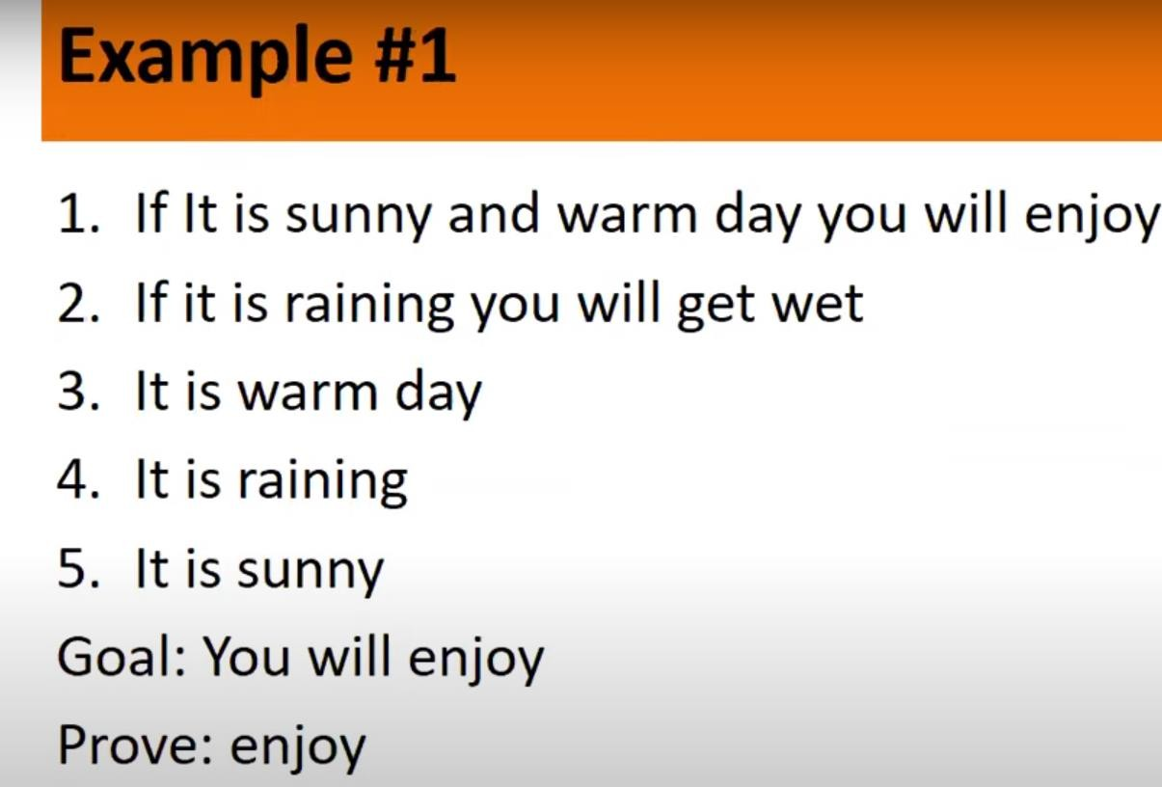

Slide 44
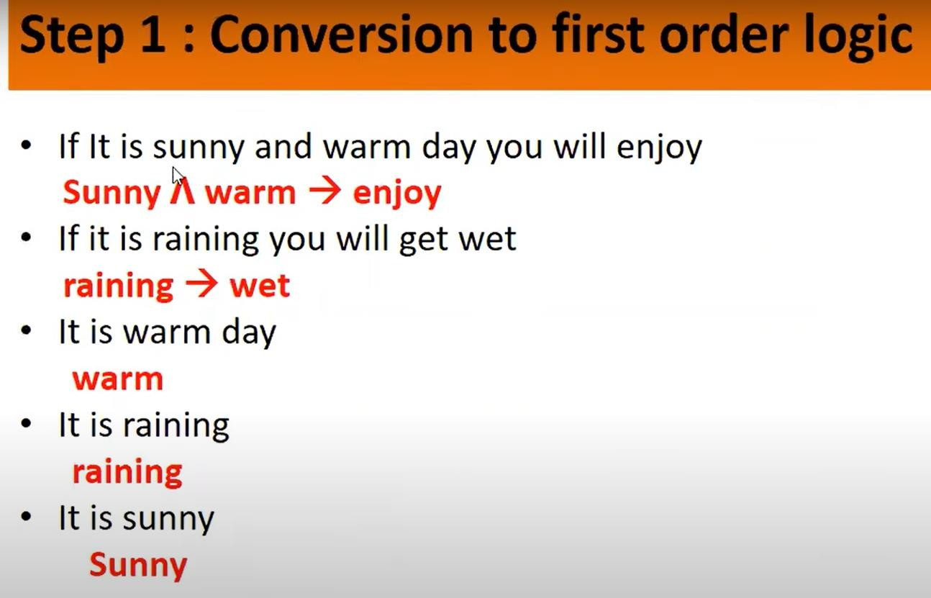

Slide 45
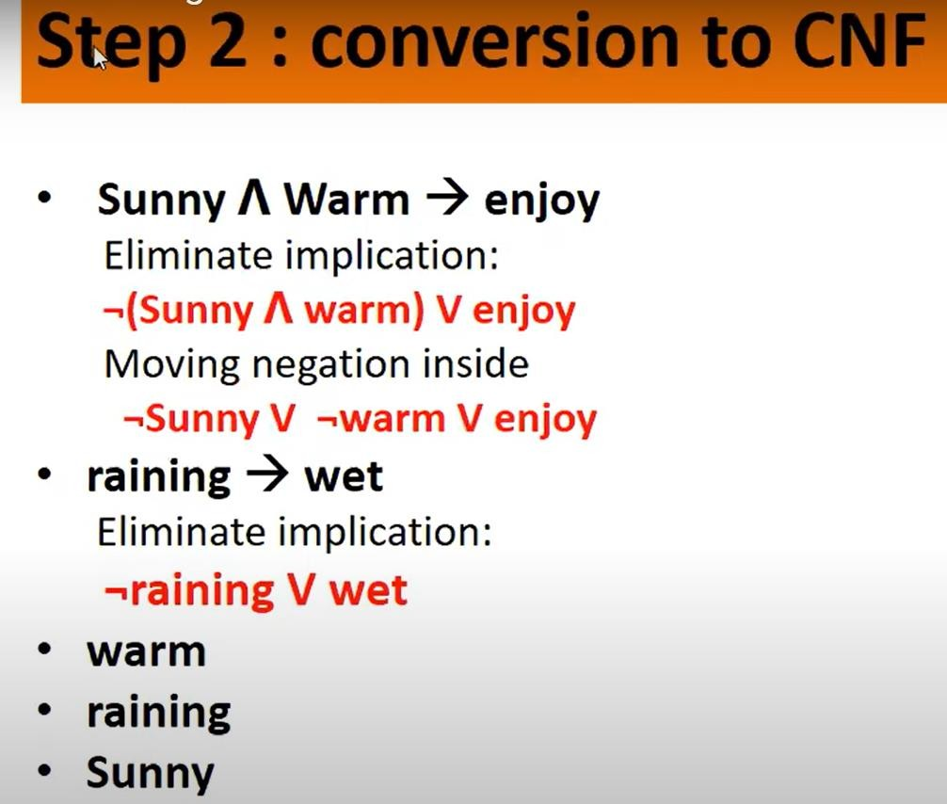

Slide 46
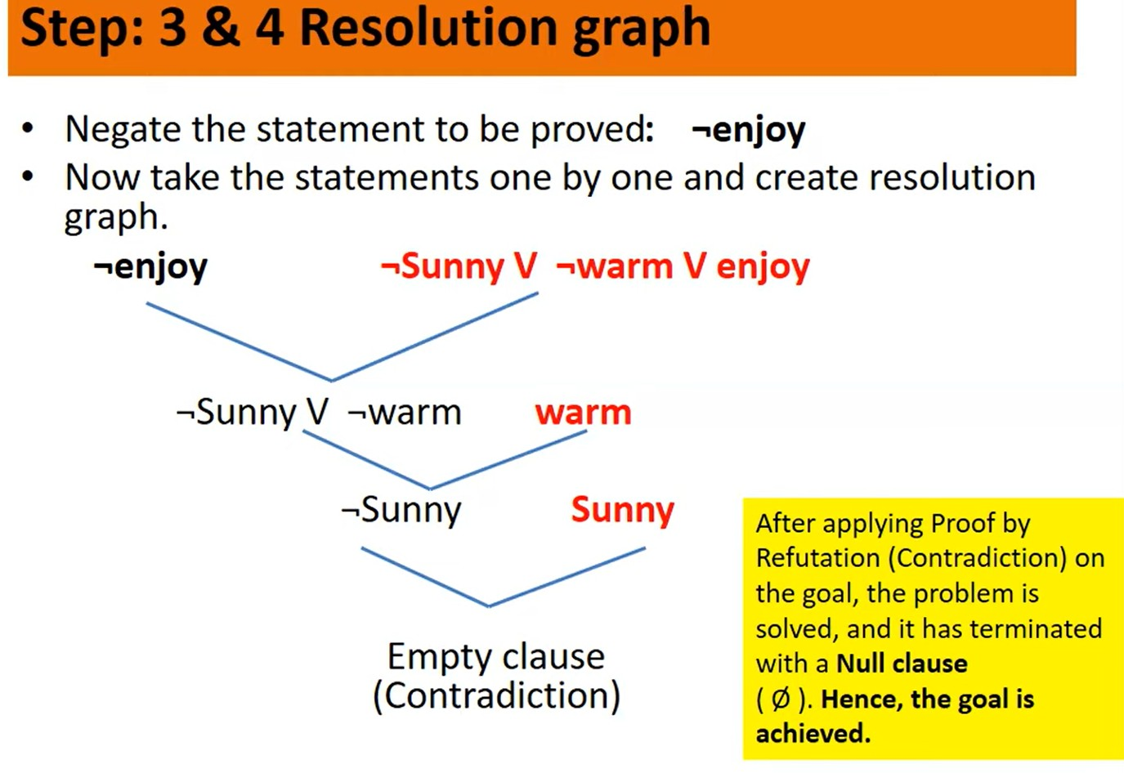

Slide 47
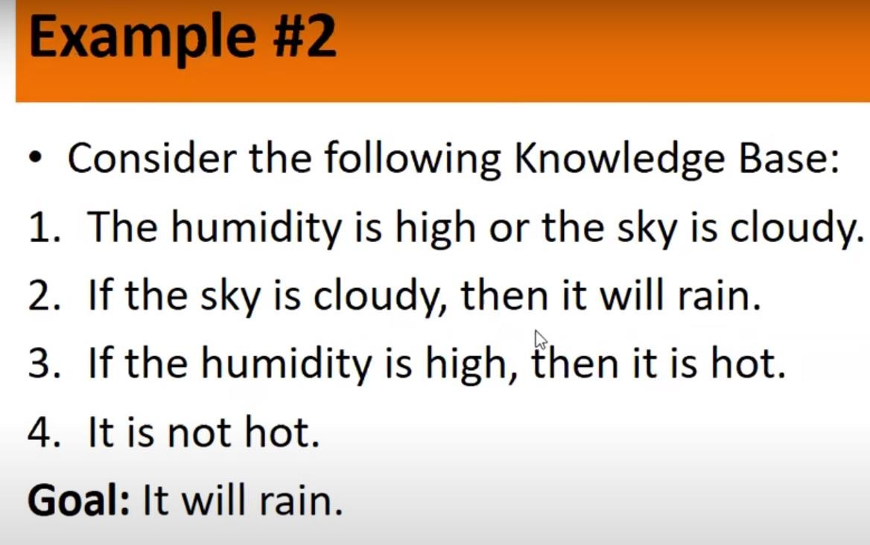

Slide 48
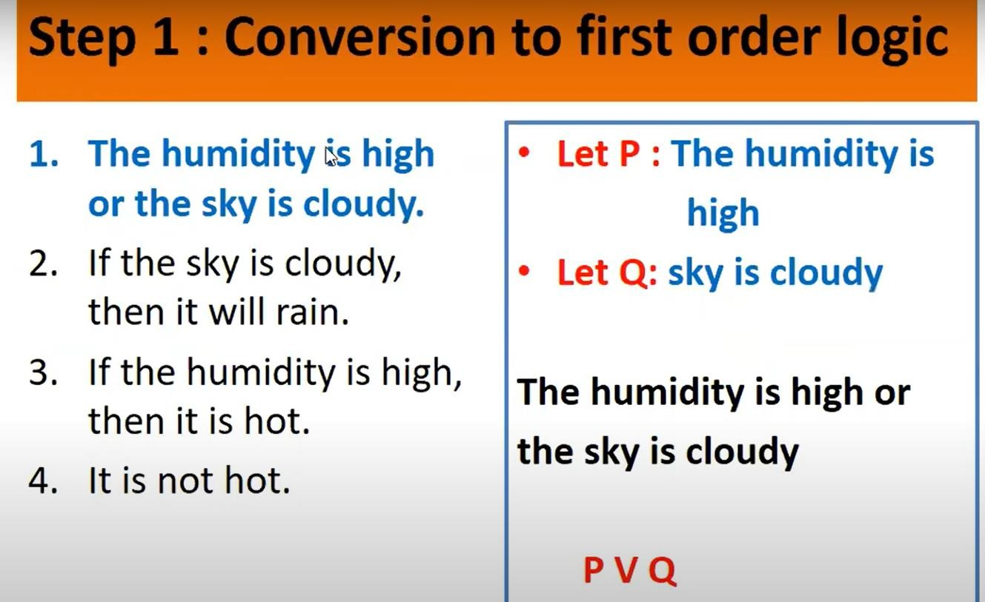

Slide 49
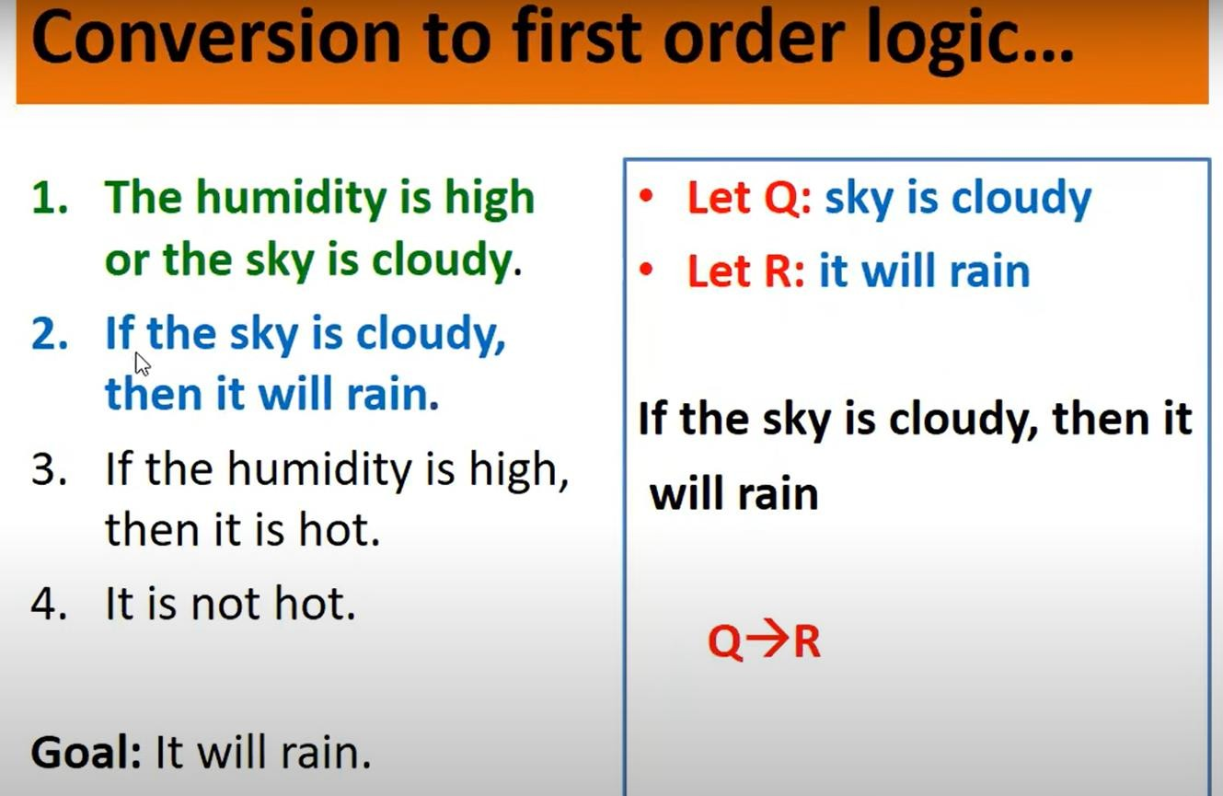

Slide 50
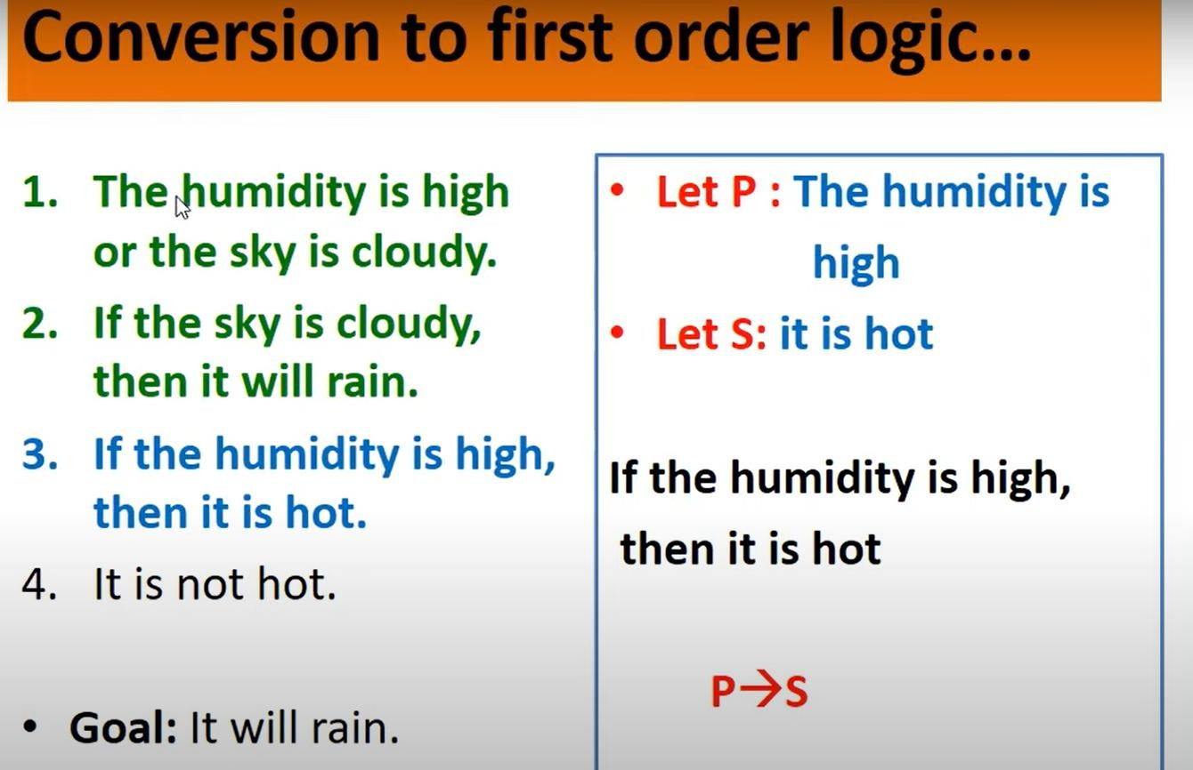

Slide 51
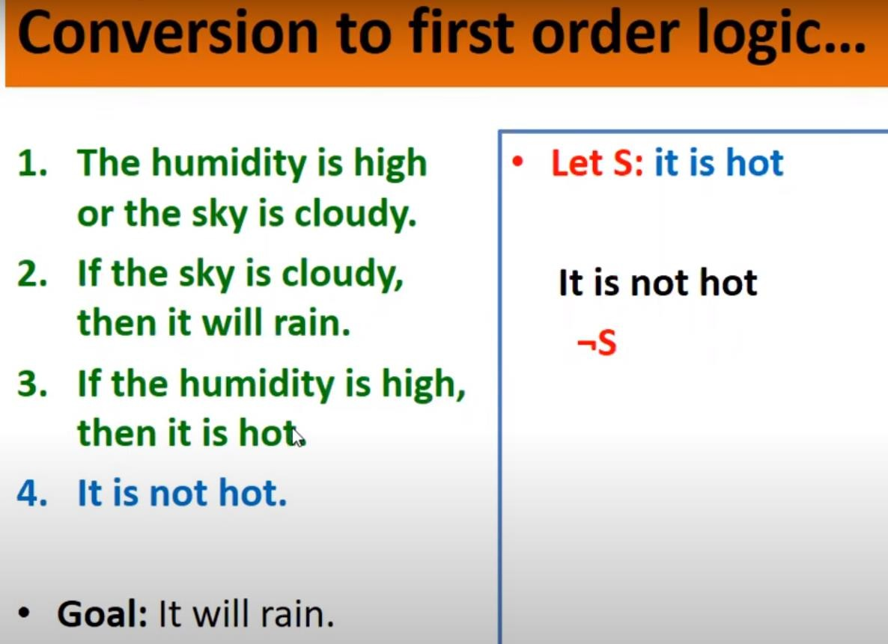

Slide 52
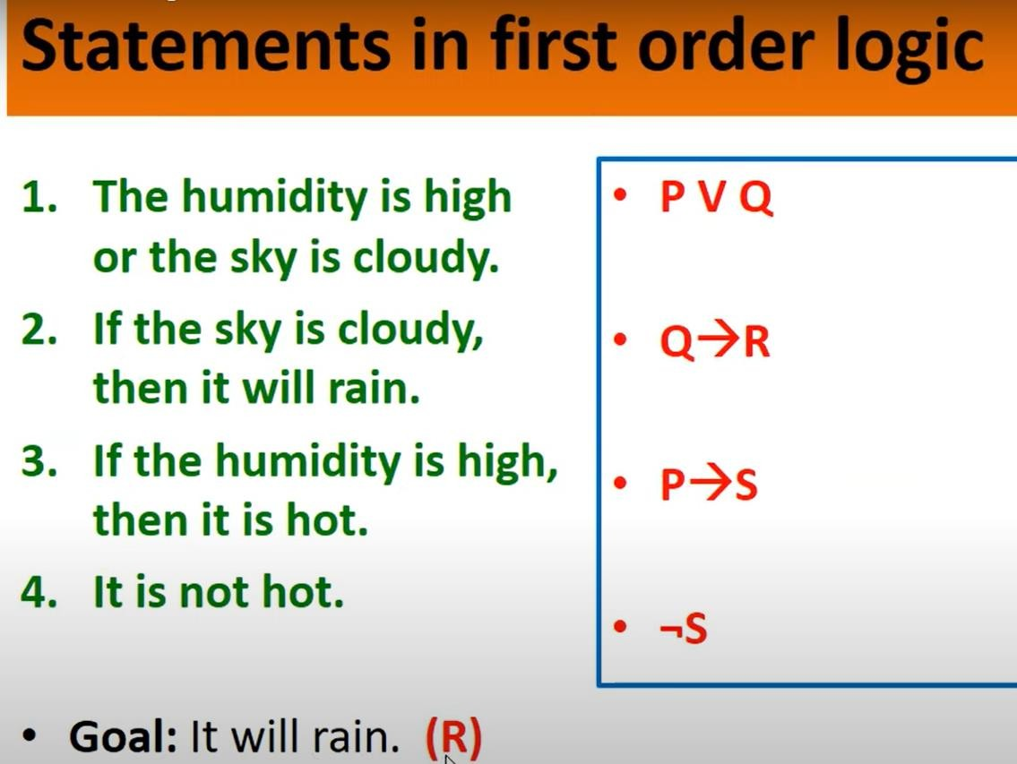

Slide 53
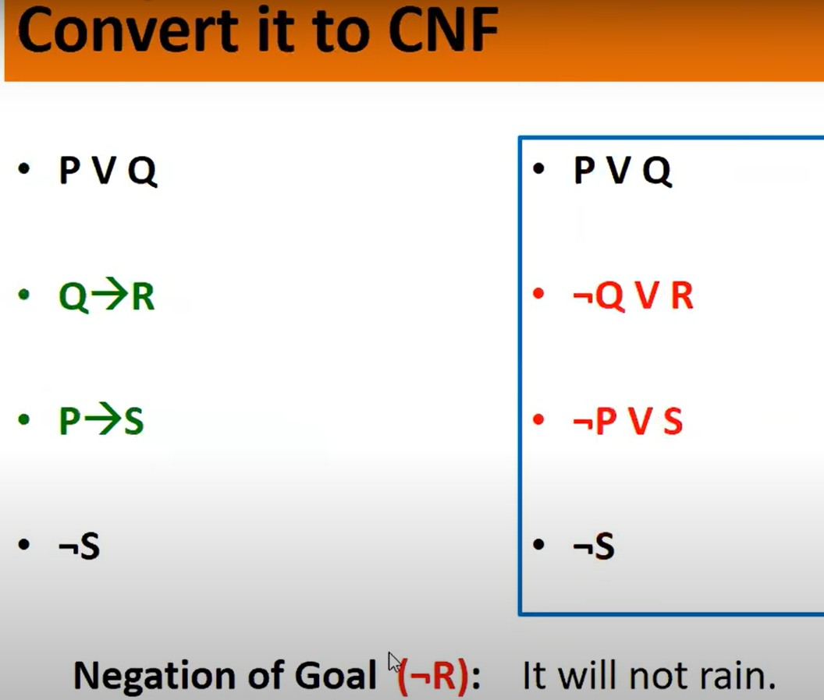

Slide 54
END of Unit 2

